Slide 1

Chapter 5
Network Layer:
The Control Plane
Computer Networking: A Top Down Approach
7th edition
Jim Kurose, Keith Ross
Pearson/Addison Wesley
April 2016

Slide 2
Routing protocols
Routing protocol goal: determine “good” paths (equivalently, routes), from sending hosts to receiving host, through network of routers
path: sequence of routers packets will traverse in going from given initial source host to given final destination host
“good”: least “cost”, “fastest”, “least congested”
routing: a “top-10” networking challenge!

Slide 3
Routing algorithm classification
Q: global or decentralized information?
global:
all routers have complete topology, link cost info
“link state” algorithms
decentralized:
router knows physically-connected neighbors, link costs to neighbors
iterative process of computation, exchange of info with neighbors
“distance vector” algorithms
Q: static or dynamic?
static:
routes change slowly over time
dynamic:
routes change more quickly
  periodic update
  in response to link cost changes

Slide 4
A link-state routing algorithm
Dijkstra’s algorithm
net topology, link costs known to all nodes
  accomplished via “link state broadcast”
  all nodes have same info
computes least cost paths from one node (‘source”) to all other nodes
  gives forwarding table for that node
iterative: after k iterations, know least cost path to k dest.’s
notation:
c(x,y): link cost from node x to y; = ∞ if not direct neighbors
D(v): current value of cost of path from source to dest. v
p(v): predecessor node along path from source to v
N': set of nodes whose least cost path definitively known

Slide 5
Dijsktra’s algorithm
1 Initialization:
2 N' = {u}
3 for all nodes v
4 if v adjacent to u
5 then D(v) = c(u,v)
6 else D(v) = ∞
7
8 Loop
9 find w not in N' such that D(w) is a minimum
10 add w to N'
11 update D(v) for all v adjacent to w and not in N' :
12 D(v) = min( D(v), D(w) + c(w,v) )
13 /* new cost to v is either old cost to v or known
14 shortest path cost to w plus cost from w to v */
15 until all nodes in N'

Slide 6
Dijkstra’s algorithm: example
D(v)
p(v)
D(w)
p(w)
D(x)
p(x)
D(y)
p(y)
D(z)
p(z)
Step
N'
0
u
7,u
3,u
5,u
∞
∞
1
uw
6,w
5,u
11,w
∞
2
uwx
6,w
11,w
14,x
3
uwxv
10,v
14,x
4
uwxvy
12,y
5
uwxvyz
x
9
notes:
construct shortest path tree by tracing predecessor nodes
ties can exist (can be broken arbitrarily)
5
7
4
8
u
3
w
y
z
2
3
7
4
v

Slide 7
Dijkstra’s algorithm, discussion
algorithm complexity: n nodes
each iteration: need to check all nodes, w, not in N
n(n+1)/2 comparisons: O(n²)
more efficient implementations possible: O(nlogn)
oscillations possible:
e.g., support link cost equals amount of carried traffic:
A
A
A
A
1
1+e
2+e
0
0
2+e
2+e
0
D
B
D
B
D
B
D
B
0
0
1+e
1
0
0
1+e
1
0
C
e
0
0
1
0
0
1
C
C
1+e
C
1
e
initially
given these costs,
find new routing….
resulting in new costs
given these costs,
find new routing….
resulting in new costs
given these costs,
find new routing….
resulting in new costs

Slide 8
Distance vector algorithm
Bellman-Ford equation (dynamic programming)
let
d_{x}(y) := cost of least-cost path from x to y
then
d_{x}(y) = min {c(x,v) + d_{v}(y) }
v
cost from neighbor v to destination y
cost to neighbor v
min taken over all neighbors v of x

Slide 9
Bellman-Ford example
5
clearly, d_{v}(z) = 5, d_{x}(z) = 3, d_{w}(z) = 3
v
3
w
2
5
u
z
B-F equation says:
2
1
3
1
2
d_{u}(z) = min { c(u,v) + d_{v}(z),
c(u,x) + d_{x}(z),
c(u,w) + d_{w}(z) }
= min {2 + 5,
1 + 3,
5 + 3} = 4
x
y
1
node achieving minimum is next
hop in shortest path, used in forwarding table

Slide 10
D_{x}(z) = min{c(x,y) +
D_{y}(z), c(x,z) + D_{z}(z)}
= min{2+1 , 7+0} = 3
D_{x}(y) = min{c(x,y) + D_{y}(y), c(x,z) + D_{z}(y)}
= min{2+0 , 7+1} = 2
node x
table
cost to
cost to
x y z
x y z
x
0 2 7
x
0
2
3
y
y
2 0 1
from
∞
∞
∞
from
z
∞
∞
∞
z
7 1 0
node y
table
cost to
x y z
y
2
1
x
∞
∞
z
∞
2 0 1
x
from
y
7
z
∞
∞
∞
node z
table
cost to
x y z
x
∞ ∞ ∞
from
y
∞
∞
∞
z
7
1
0
time

Slide 11
D_{x}(z) = min{c(x,y) +
D_{y}(z), c(x,z) + D_{z}(z)}
= min{2+1 , 7+0} = 3
D_{x}(y) = min{c(x,y) + D_{y}(y), c(x,z) + D_{z}(y)}
= min{2+0 , 7+1} = 2
node x
table
cost to
cost to
cost to
x y z
x y z
x y z
x
0 2 7
x
0
2
3
x
0 2 3
y
y
2 0 1
from
∞
∞
∞
from
y
2 0 1
z
z
from
∞
∞
∞
7 1 0
z
3 1 0
node y
table
cost to
cost to
cost to
x y z
x y z
x y z
y
2
1
x
∞
∞
x
0 2 7
∞
2 0 1
x
0 2 3
x
z
from
y
y
2 0 1
y
7
from
from
2 0 1
z
∞
∞
∞
z
7 1 0
z
3 1 0
node z
table
cost to
cost to
cost to
x y z
x y z
x y z
x
∞ ∞ ∞
x
0 2 7
x
0 2 3
y
y
2 0 1
from
y
∞
∞
from
2 0 1
from
∞
z
z
3 1 0
z
3 1 0
7
1
0
time
time

Slide 12
Distance vector: link cost changes
link cost changes:
node detects local link cost change
updates routing info, recalculates
distance vector
if DV changes, notify neighbors
1
y
4
1
x
z
50
“good
news
travels
fast”
t₀ : y detects link-cost change, updates its DV, informs its neighbors.
t₁ : z receives update from y, updates its table, computes new least cost to x , sends its neighbors its DV.
t₂ : y receives z’s update, updates its distance table. y’s least costs do not change, so y does not send a message to z.
* Check out the online interactive exercises for more examples: http://gaia.cs.umass.edu/kurose_ross/interactive/

Slide 13
Distance vector: link cost changes
link cost changes:
node detects local link cost change
bad news travels slow - “count to infinity” problem!
44 iterations before algorithm stabilizes: see text
60
y
4
1
x
z
50
poisoned reverse:
If Z routes through Y to get to X :
  Z tells Y its (Z’s) distance to X is infinite (so Y won’t route to X via Z)
will this completely solve count to infinity problem?

Slide 14
Comparison of LS and DV algorithms
message complexity
LS: with n nodes, E links, O(nE) msgs sent
DV: exchange between neighbors only
  convergence time varies
speed of convergence
LS: O(n²) algorithm requires O(nE) msgs
  may have oscillations
DV: convergence time varies
  may be routing loops
  count-to-infinity problem
robustness: what happens if router malfunctions?
LS:
  node can advertise incorrect link cost
  each node computes only its own table
DV:
  DV node can advertise incorrect path cost
  each node’s table used by others
    error propagate thru network

Slide 15
Making routing scalable
our routing study thus far - idealized
all routers identical
network “flat”
… not true in practice
scale: with billions of destinations:
can’t store all destinations in routing tables!
routing table exchange would swamp links!
administrative autonomy
internet = network of networks
each network admin may want to control routing in its own network

Slide 16
Internet approach to scalable routing
aggregate routers into regions known as “autonomous systems” (AS) (a.k.a. “domains”)
intra-AS routing
routing among hosts, routers in same AS (“network”)
all routers in AS must run same intra-domain protocol
routers in different AS can run different intra-domain routing protocol
gateway router: at “edge” of its own AS, has link(s) to router(s) in other AS’es
inter-AS routing
routing among AS’es
gateways perform inter-domain routing (as well as intra-domain routing)

Slide 17
Interconnected ASes
3c
3a
2c
3b
AS3
2a
1c
2b
AS2
1a
1b
1d
AS1
forwarding table configured by both intra- and inter-AS routing algorithm
  intra-AS routing determine entries for destinations within AS
  inter-AS & intra-AS determine entries for external destinations
Intra-AS
Routing
algorithm
Inter-AS
Routing
algorithm
Forwarding
table

Slide 18
Internet inter-AS routing: BGP
BGP (Border Gateway Protocol): the de facto inter-domain routing protocol
  “glue that holds the Internet together”
BGP provides each AS a means to:
  eBGP: obtain subnet reachability information from neighboring ASes
  iBGP: propagate reachability information to all AS-internal routers.
  determine “good” routes to other networks based on reachability information and policy
allows subnet to advertise its existence to rest of Internet: “I am here”

Slide 19
eBGP, iBGP connections
2b
∂
2a
2c
1b
3b
2d
∂
1a
1c
3a
3c
AS 2
1d
3d
AS 1
eBGP connectivity
AS 3
iBGP connectivity
1c
gateway routers run both eBGP and iBGP protools

Slide 20
BGP basics
BGP session: two BGP routers (“peers”) exchange BGP messages over semi-permanent TCP connection:
  advertising paths to different destination network prefixes (BGP is a “path vector” protocol)
when AS3 gateway router 3a advertises path AS3,X to AS2 gateway router 2c:
  AS3 promises to AS2 it will forward datagrams towards X
AS 3
3b
AS 1
1b
3a
3c
1a
1c
AS 2
2b
3d
X
1d
2a
2c
BGP advertisement:
AS3, X
2d

Slide 21
BGP path advertisement
AS3
3b
AS1
1b
AS3,X
3a
3c
1a
1c
AS2
2b
3d
X
1d
AS3,X
AS2,AS3,X
2a
2c
2d
gateway router may learn about multiple paths to destination:
AS1 gateway router 1c learns path AS2,AS3,X from 2a
AS1 gateway router 1c learns path AS3,X from 3a
Based on policy, AS1 gateway router 1c chooses path AS3,X, and advertises path within AS1 via iBGP
ANYCAST uses the same concept above to locate nearest servers with same IP address

Slide 22
Why different Intra-, Inter-AS routing ?
policy:
inter-AS: admin wants control over how its traffic routed, who routes through its net.
intra-AS: single admin, so no policy decisions needed
scale:
hierarchical routing saves table size, reduced update traffic
performance:
intra-AS: can focus on performance
inter-AS: policy may dominate over performance

Slide 23
Unicast vs. Multicast
Multicast provides multipoint-to-multipoint communication
Today majority of Internet applications rely on point-to-point transmission (e.g., TCP).
IP-Multicast conserves bandwidth by replicating packets in the network only when necessary
Multicast address is class ‘D’ address:
  224.0.0.0 to 239.255.255.255
  if the dst IP address belongs in this range packet is routed through the multicast routing/forwarding mechanism

Slide 24
Unicast vs. Multicast
S
S
R1
R1
R2
R2
R3
R4
R3
R4
Multiple unicasts
(18 link traversals)
Multicast
(9 link traversals)

Slide 25
Example Multicast Applications
One-to-Many
  Today:
    Push data between CDN clusters, data centers, and caches for replication (availability), fault-tolerance, and improved performance
    IPTV delivery by ISPs for efficient delivery and reduced congestion
  Scheduled audio/video distribution: lectures, presentations
  Push media: news headlines, weather updates
  Caching: web site content & other file-based updates sent to distributed replication/caching sites
  Announcements: network time, configuration updates
  Monitoring: stock prices, sensor equipment

Slide 26
IP Multicast Applications (contd.)
  Many-to-Many
    Multimedia Teleconferencing (audio, video, shared whiteboard, text editor)
    Collaboration
    Multi-Player Games
    Concurrent Processing
    Chat Groups
    Distributed Interactive Simulation, Virtual Reality (VR), Augmented Reality (AR)

Slide 27
Multicast Routing Protocols
In general, there are two classes of multicast routing protocols:
  Dense-mode protocols (broadcast-and-prune)
    DVMRP (distance vector multicast routing protocol)
    MOSPF (multicast open shortest path first)
    PIM-DM (protocol independent multicast, dense mode)
  Sparse-mode protocols (explicit-join)
    PIM-SM* (protocol independent multicast, sparse mode)
    CBT (core-based trees)
    BGMP (border gateway multicast protocol)
* the Internet standard for IP multicast, PIM-SM:
- RFC 2362, Estrin, Farinacci, Helmy, Thaler, Jacobson, Deering, et al., 1998

Slide 28
Dense vs. Sparse Mode Multicast
S
R1
R2
R3
R4
Dense-Mode Multicast
(broadcast and prune)

Slide 29
Dense vs. Sparse Mode Multicast
S
S
R1
R1
Root
R2
R2
R3
R3
R4
R4
Dense-Mode Multicast
(broadcast and prune)
Sparse-Mode Multicast
(explicit join)

Slide 30
Reverse Path Multicasting (RPM)

Slide 31
Distance Vector Multicast Routing Protocol (DVMRP)
DVMRP constructs source-rooted trees using variants of RPM (broadcast-and-prune)
The first packet for any (source, group) pair is broadcast to the entire network
Leaf routers with no local members send prune messages back toward the source
* S. Deering, 1988, 89

Slide 32
Example DVMRP scenario
g
g
s
S: sender
g: group member
g

Slide 33
1. Initial Truncated Broadcast
g
g
s
S: sender
g: group member
g

Slide 34
2. Prune non-member branches
g
g
store prune state
off-tree
(soft state)
prune (s,g)
s
prune (s,g)
S: sender
g: group member
g

Slide 35
3. Graft new members
g
g
g
report (g)
graft (s,g)
s
graft (s,g)
S: sender
g: group member
g

Slide 36
DVMRP distribution tree
g
g
established tree:
- rooted at the source
- leading to members
g
s
S: sender
g: group member
g

Slide 37
DVMRP forwarding table
p: received prune from downstream
Pr: sent prune upstream (towards the source)

Slide 38
Multicast extensions to OSPF (MOSPF)
MOSPF routers maintain network topology via OSPF
MOSPF uses group mgmt. (IGMP) to discover members
Routers flood Group-Membership Link State Advertisements (LSAs) throughout the OSPF domain
The shortest path tree for (S, G) pair is built "on demand" when a router receives the first (S,G) packet
When the initial packet arrives, the source subnet is located in MOSPF link state database.
  MOSPF LS-DB = OSPF LS-DB + Group-Membership LSAs
  i.e., extends OSPF link state database with membership info

Slide 39
Limitations of broadcast-and-prune
MOSPF is limited to OSPF domains
MOSPF and DVMRP keep state off-tree as well as on-tree
Flooding information does not scale well for Internet-wide multicast
  MOSPF floods membership info
  DVMRP floods packets (initially and periodically)

Slide 40
Protocol-independent Multicast (PIM)
Design Rationale
Broadcast and prune keeps state off-tree and is suitable when members are densely distributed
Explicit join/center-based approach keeps state on-tree and is suitable when members are sparsely distributed
PIM attempts to combine the best of both worlds
  PIM-DM: broadcat-and-prune for dense groups
  PIM-SM: shared-tree for sparse groups
    root tree at ‘rendezvous point’ (RP)
    this is how senders and receivers meet without broadcast
rendezvous problem

Slide 41
Design choices
Shared trees or shortest path trees?
  Both: use shared trees to ‘Rendezvous’ then switch to shortest path to deliver
  Problem of choosing optimal rendezvous point (RP) is NP-complete based on the Steiner-tree (ST) problem
  PIM-SM side-steps this hard problem, and does not attempt to optimize the RP, esp. membership is dynamic!
DV or LS for routing?
  Use routing tables regardless of which protocol created them (hence the name ‘Protocol Independent’)

Slide 42
How PIM-SM works
A Rendezvous Point (RP) is chosen as tree center per group to enable members and senders to “meet”
Members send their explicit joins toward the RP
Senders send their packets to the RP
Packets flow only where there is join state
(*,G) [any-source,group] state is kept in routers between receivers and the RP
Once the packets get to the receiver, then it will know who the source is and can switch to shortest path. RP doesn’t forward packets to receiver thereafter.

Slide 43
How PIM-SM works
Source
(S)
A
B
RP
D
C
E
Link
(*,G) Data
(S,G) Data
Control
Receiver 1
(R1)
Receiver 2
(R2)

Slide 44
How PIM-SM works
Source
(S)
A
B
RP
D
C
E
Link
(*,G) Data
(S,G) Data
Control
(*, G)
Join
Receiver 1
(R1)
Receiver 2
(R2)
R1 joins group, sends a join from C to RP

Slide 45
How PIM-SM works
Source
(S)
A
B
RP
D
C
E
Link
(*,G) Data
(S,G) Data
Control
Receiver 1
(R1)
Receiver 2
(R2)
routers on the way from RP to R1 save soft state (at C)

Slide 46
How PIM-SM works
Source
(S)
Register
A
B
RP
D
C
E
Link
(*,G) Data
(S,G) Data
Control
Receiver 1
(R1)
Receiver 2
(R2)
Source sends packets to group G, A tunnels packets (called Registers) to RP

Slide 47
How PIM-SM works
Source
(S)
A
B
RP
D
(S, G) Join
Link
(*,G) Data
(S,G) Data
Control
C
E
Receiver 1
(R1)
Receiver 2
(R2)
after receiving data from Srouce, R1 is switched to shortest path by C sending join to A

Slide 48
How PIM-SM works
Source
(S)
A
B
RP
D
C
E
Link
(*,G) Data
(S,G) Data
Control
Receiver 1
(R1)
Receiver 2
(R2)
end result: shortest path tree from source to members without broadcasts
… more details in grad level class ☺

Slide 49
Chapter 4
Network Layer:
The Data Plane
Computer Networking: A Top Down Approach
7th edition
Jim Kurose, Keith Ross
Pearson/Addison Wesley
April 2016

Slide 50
Two key network-layer functions
network-layer functions:
forwarding: move packets from router’s input to appropriate router output
routing: determine route taken by packets from source to destination
  routing algorithms
analogy: taking a trip
forwarding: process of getting through single interchange
routing: process of planning trip from source to destination

Slide 51
Network layer: data plane, control plane
Data plane
local, per-router function
determines how datagram arriving on router input port is forwarded to router output port
forwarding function
Control plane
network-wide logic
determines how datagram is routed among routers along end-end path from source host to destination host
two control-plane approaches:
  traditional routing algorithms: implemented in routers
  software-defined networking (SDN): implemented in (remote) servers
values in arriving
packet header
0111
1
3
2

Slide 52
Per-router control plane
Individual routing algorithm components in each and every router interact in the control plane
Routing
Algorithm
control
plane
data
plane
values in arriving
packet header
0111
1
3
2

Slide 53
Logically centralized control plane
A distinct (typically remote) controller interacts with local control agents (CAs)
Remote Controller
control
plane
data
plane
CA
CA
CA
CA
CA
values in arriving
packet header
0111
1
3
2

Slide 54
Router architecture overview
high-level view of generic router architecture:
routing, management
control plane (software)
operates in millisecond
time frame
routing
processor
forwarding data plane (hardware) operates in nanosecond timeframe
high-seed
switching
fabric
router input ports
router output ports

Slide 55
Input port functions
lookup,
forwarding
queueing
line
termination
link
layer
protocol
(receive)
switch
fabric
physical layer:
bit-level reception
decentralized switching:
using header field values, lookup output port using forwarding table in input port memory (“match plus action”)
destination-based forwarding: forward based only on destination IP address (traditional)
generalized forwarding: forward based on any set of header field values
data link layer:
e.g., Ethernet
see chapter 5

Slide 56
Longest prefix matching
longest prefix matching
when looking for forwarding table entry for given destination address, use longest address prefix that matches destination address.
Destination Address Range
11001000 00010111 00010*** *********
11001000 00010111 00011000 *********
11001000 00010111 00011*** *********
otherwise
Link interface
0
1
2
3
examples:
DA: 11001000 00010111 00010110 10100001
which interface?
DA: 11001000 00010111 00011000 10101010
which interface?

Slide 57
Interplay between routing and forwarding
routing algorithm
local forwarding table
header value
output link
0100
0101
0111
1001
3
2
2
1
value in arriving
packet’s header
0111
1
3
2

Slide 58
Scheduling mechanisms
scheduling: choose next packet to send on link
FIFO (first in first out) scheduling: send in order of arrival to queue
  real-world example?
  discard policy: if packet arrives to full queue: who to discard?
    tail drop: drop arriving packet
    priority: drop/remove on priority basis
    random: drop/remove randomly
packet
arrivals
packet
departures
queue
(waiting area)
link
(server)

Slide 59
Scheduling policies: priority
priority scheduling: send highest priority queued packet
multiple classes, with different priorities
  class may depend on marking or other header info, e.g. IP source/dest, port numbers, etc.
  real world example?
high priority queue
(waiting area)
arrivals
departures
classify
link
(server)
low priority queue
(waiting area)
2
1
3
4
5
arrivals
packet in service
1
3
2
4
5
departures
1
3
2
4
5

Slide 60
Scheduling policies: still more
Round Robin (RR) scheduling:
multiple classes
cyclically scan class queues, sending one complete packet from each class (if available)
real world example?
2
1
3
4
5
arrivals
packet in service
1
3
2
4
5
departures
1
3
2
4
5

Slide 61

Scheduling policies: still more
Weighted Fair Queuing (WFQ):
generalized Round Robin
each class gets weighted amount of service in each cycle
real-world example?

Slide 62
The Internet network layer
host, router network layer functions:
transport layer: TCP, UDP
routing protocols
path selection
RIP, OSPF, BGP
IP protocol
addressing conventions
datagram format
packet handling conventions
network
layer
forwarding
table
ICMP protocol
error reporting
router “signaling”
link layer
physical layer
RIP: routing information protocol, distance vector (Bellman-Ford algorithm), intra-domain
OSPF: open shortest path first, link state (Dijkstra’s algorithm), intra-domain
BGP: borader gateway protocol, inter-domain routing
ICMP: Internet control message protocol, used in ping, traceroute

Slide 63
IP datagram format
IP protocol version
number
32 bits
total datagram
length (bytes)
header length
(bytes)
head.
len
type of
service
ver
length
for
fragmentation/
reassembly
“type” of data
flgs
fragment
offset
16-bit identifier
max number
remaining hops
(decremented at
each router)
time to
live
upper
layer
header
checksum
32 bit source IP address
upper layer protocol
to deliver payload to
32 bit destination IP address
options (if any)
e.g. timestamp,
record route
taken, specify
list of routers
to visit.
data
(variable length,
typically a TCP
or UDP segment)
how much overhead?
20 bytes of TCP
20 bytes of IP
= 40 bytes + app layer overhead

Slide 64


IP fragmentation, reassembly
network links have MTU (max.transfer size) - largest possible link-level frame
  different link types, different MTUs
large IP datagram divided (“fragmented”) within net
  one datagram becomes several datagrams
  “reassembled” only at final destination
  IP header bits used to identify, order related fragments
…
fragmentation:
in: one large datagram
out: 3 smaller datagrams
reassembly
…

Slide 65

IP addressing: introduction
223.1.1.1
IP address: 32-bit identifier for host, router interface
interface: connection between host/router and physical link
  router’s typically have multiple interfaces
  host typically has one or two interfaces (e.g., wired Ethernet, wireless 802.11)
IP addresses associated with each interface
223.1.2.1
223.1.1.2
223.1.1.4
223.1.2.9
223.1.1.3
223.1.3.27
223.1.2.2
223.1.3.1
223.1.3.2
223.1.1.1 = 11011111 00000001 00000001 00000001
223
1
1
1

Slide 66
Subnets
223.1.1.0/24
223.1.2.0/24
recipe
to determine the subnets, detach each interface from its host or router, creating islands of isolated networks
each isolated network is called a subnet
223.1.1.1
223.1.1.2
223.1.2.1
223.1.1.4
223.1.2.9
223.1.2.2
223.1.1.3
223.1.3.27
subnet
223.1.3.1
223.1.3.2
223.1.3.0/24
subnet mask: /24

Slide 67
IP addressing: CIDR
CIDR: Classless InterDomain Routing
  subnet portion of address of arbitrary length
  address format: a.b.c.d/x, where x is # bits in subnet portion of address
subnet
part
host
part
11001000 00010111 00010000 00000000
200.23.16.0/23

Slide 68
IP addresses: how to get one?
Q: how does network get subnet part of IP addr?
A: gets allocated portion of its provider ISP’s address space
ISP's block 11001000 00010111 00010000 00000000 200.23.16.0/20
Organization 0 11001000 00010111 00010000 00000000 200.23.16.0/23
Organization 1 11001000 00010111 00010010 00000000 200.23.18.0/23
Organization 2 11001000 00010111 00010100 00000000 200.23.20.0/23
... ….. …. ….
Organization 7 11001000 00010111 00011110 00000000 200.23.30.0/23

Slide 69
Hierarchical addressing: route aggregation
hierarchical addressing allows efficient advertisement of routing
information:
Organization 0
200.23.16.0/23
Organization 1
200.23.18.0/23
“Send me anything
with addresses
beginning
200.23.16.0/20”
Organization 2
200.23.20.0/23
.
Fly-By-Night-ISP
.
.
.
.
Internet
Organization 7
.
200.23.30.0/23
ISPs-R-Us
“Send me anything
with addresses
beginning
199.31.0.0/16”

Slide 70
Hierarchical addressing: more specific routes
ISPs-R-Us has a more specific route to Organization 1
Organization 0
200.23.16.0/23
“Send me anything
with addresses
beginning
200.23.16.0/20”
Organization 2
200.23.20.0/23
.
Fly-By-Night-ISP
.
.
.
.
Internet
Organization 7
.
200.23.30.0/23
ISPs-R-Us
“Send me anything
with addresses
beginning 199.31.0.0/16
or 200.23.18.0/23”
Organization 1
200.23.18.0/23

Slide 71
NAT: network address translation
rest of
Internet
local network
(e.g., home network)
10.0.0/24
10.0.0.1
10.0.0.4
10.0.0.2
138.76.29.7
10.0.0.3
all datagrams leaving local
network have same single source NAT IP address: 138.76.29.7,different source port numbers
datagrams with source or
destination in this network
have 10.0.0/24 address for
source, destination (as usual)

Slide 72
NAT: network address translation
motivation: local network uses just one IP address as far as outside world is concerned:
  range of addresses not needed from ISP: just one IP address for all devices
  can change addresses of devices in local network without notifying outside world
  can change ISP without changing addresses of devices in local network
  devices inside local net not explicitly addressable, visible by outside world (a security plus)

Slide 73
NAT: network address translation
implementation: NAT router must:
  outgoing datagrams: replace (source IP address, port #) of every outgoing datagram to (NAT IP address, new port #)
    . . . remote clients/servers will respond using (NAT IP address, new port #) as destination addr
  remember (in NAT translation table) every (source IP address, port #) to (NAT IP address, new port #) translation pair
  incoming datagrams: replace (NAT IP address, new port #) in dest fields of every incoming datagram with corresponding (source IP address, port #) stored in NAT table

Slide 74
NAT: network address translation
NAT translation table
WAN side addr LAN side addr
2: NAT router
changes datagram
source addr from
10.0.0.1, 3345 to
138.76.29.7, 5001,
updates table
1: host 10.0.0.1
sends datagram to
128.119.40.186, 80
138.76.29.7, 5001 10.0.0.1, 3345
…… ……
S: 10.0.0.1, 3345
D: 128.119.40.186, 80
10.0.0.1
1
2
S: 138.76.29.7, 5001
D: 128.119.40.186, 80
10.0.0.4
10.0.0.2
138.76.29.7
S: 128.119.40.186, 80
D: 10.0.0.1, 3345
4
S: 128.119.40.186, 80
D: 138.76.29.7, 5001
3
10.0.0.3
4: NAT router
changes datagram
dest addr from
138.76.29.7, 5001 to 10.0.0.1, 3345
3: reply arrives
dest. address:
138.76.29.7, 5001
* Check out the online interactive exercises for more examples: http://gaia.cs.umass.edu/kurose_ross/interactive/

Slide 75
IPv6: motivation
initial motivation: 32-bit address space soon to be completely allocated.
additional motivation:
  header format helps speed processing/forwarding
  header changes to facilitate QoS
IPv6 datagram format:
  fixed-length 40 byte header
  no fragmentation allowed

Slide 76
IPv6 datagram format
priority: identify priority among datagrams in flow
flow Label: identify datagrams in same “flow.”
(concept of“flow” not well defined).
next header: identify upper layer protocol for data
ver
pri
flow label
payload len
next hdr
hop limit
source address
(128 bits)
destination address
(128 bits)
data
32 bits

Slide 77
Other changes from IPv4
checksum: removed entirely to reduce processing time at each hop
options: allowed, but outside of header, indicated by “Next Header” field
ICMPv6: new version of ICMP
  additional message types, e.g. “Packet Too Big”
  multicast group management functions

Slide 78
Transition from IPv4 to IPv6
not all routers can be upgraded simultaneously
  no “flag days”
  how will network operate with mixed IPv4 and IPv6 routers?
tunneling: IPv6 datagram carried as payload in IPv4 datagram among IPv4 routers
IPv4 header fields
IPv6 header fields
IPv4 payload
IPv4 source, dest addr
IPv6 source dest addr
UDP/TCP payload
IPv6 datagram
IPv4 datagram

Slide 79
Tunneling
A
B
IPv4 tunnel
connecting IPv6 routers
E
F
logical view:
IPv6
IPv6
IPv6
IPv6
A
B
C
D
E
F
physical view:
IPv6
IPv6
IPv4
IPv4
IPv6
IPv6

Slide 80
Tunneling
A
B
IPv4 tunnel
connecting IPv6 routers
E
F
logical view:
IPv6
IPv6
IPv6
IPv6
A
B
C
D
E
F
physical view:
IPv6
IPv6
IPv4
IPv4
IPv6
IPv6
flow: X
src: A
dest: F
data
src:B
dest: E
src:B
dest: E
flow: X
src: A
dest: F
data
Flow: X
Src: A
Dest: F
data
Flow: X
Src: A
Dest: F
data
A-to-B:
IPv6
B-to-C:
IPv6 inside
IPv4
B-to-C:
IPv6 inside
IPv4
E-to-F:
IPv6

Slide 81
Multiprotocol label switching (MPLS)
initial goal: high-speed IP forwarding using fixed length label (instead of IP address)
  fast lookup using fixed length identifier (rather than shortest prefix matching)
  borrowing ideas from Virtual Circuit (VC) approach
  but IP datagram still keeps IP address!
Ethernet header
MPLS header
IP header
remainder of link-layer frame
label
Exp
S
TTL
20
3
1
5

Slide 82
MPLS capable routers
a.k.a. label-switched router
forward packets to outgoing interface based only on label value (do not inspect IP address)
  MPLS forwarding table distinct from IP forwarding tables
flexibility: MPLS forwarding decisions can differ from those of IP
  use destination and source addresses to route flows to same destination differently (traffic engineering - TE)
  re-route flows quickly if link fails: pre-computed backup paths (useful for VoIP)

Slide 83
MPLS versus IP paths
R6
D
R4
R3
R5
A
R2
IP routing: path to destination determined by destination address alone
IP router

Slide 84
MPLS versus IP paths
entry router (R4) can use different MPLS routes to A based, e.g., on source address
R6
D
R4
R3
R5
A
R2
IP routing: path to destination determined by destination address alone
IP-only
router
MPLS routing: path to destination can be based on source and destination address
  fast reroute: precompute backup routes in case of link failure
MPLS and
IP router

Slide 85
MPLS forwarding tables
in out out
label label dest interface
10 A 0
in out out
label label dest interface
12 D 0
8 A 1
10 6 A 1
12 9 D 0
R6
0
0
D
1
1
R4
R3
R5
0
0
A
R2
in out out
label label dest interface
R1
in out out
label label dest interface
6 - A 0
8 6 A 0

Slide 86
Generalized Forwarding and SDN
Each router contains a flow table that is computed and distributed by a logically centralized routing controller
logically-centralized routing controller
control plane
data plane
local flow table
headers counters actions
1
0100 1101
3
2
values in arriving
packet’s header

Slide 87
OpenFlow data plane abstraction
flow: defined by header fields
generalized forwarding: simple packet-handling rules
  Pattern: match values in packet header fields
  Actions: for matched packet: drop, forward, modify, matched packet or send matched packet to controller
  Priority: classify overlapping flows/patterns
  Counters: #bytes and #packets
Flow table in a router (computed and distributed by controller) define router’s match+action rules

Slide 88
OpenFlow data plane abstraction
flow: defined by header fields
generalized forwarding: simple packet-handling rules
  Pattern: match values in packet header fields
  Actions: for matched packet: drop, forward, modify, matched packet or send matched packet to controller
  Priority: classify overlapping flows/patterns
  Counters: #bytes and #packets
* : wildcard
src=1.2.*.*, dest=3.4.5.* → drop
src = *.*.*.*, dest=3.4.*.* → forward(2)
3. src=10.1.2.3, dest=*.*.*.* → send to controller

Slide 89
OpenFlow: Flow Table Entries
Rule
Action
Stats
Packet + byte counters
Forward packet to port(s)
Encapsulate and forward to controller
Drop packet
Send to normal processing pipeline
Modify Fields
Switch
Port
VLAN
ID
MAC
src
MAC
dst
Eth
type
IP
Src
IP
Dst
IP
Prot
TCP
sport
TCP
dport
Link layer
Network layer
Transport layer
Notes:
Now I’ll describe the API that tries to meet these goals.
89

Slide 90
Examples
Destination-based forwarding:
Switch
Port
MAC
src
MAC
dst
Eth
type
VLAN
ID
IP
Src
IP
Dst
IP
Prot
TCP
sport
TCP
dport
Action
*
*
*
*
*
*
51.6.0.8
*
*
*
port6
IP datagrams destined to IP address 51.6.0.8 should be forwarded to router output port 6
Firewall:
Switch
Port
MAC
src
MAC
dst
Eth
type
VLAN
ID
IP
Src
IP
Dst
IP
Prot
TCP
sport
TCP
dport
Forward
*
*
*
*
*
*
*
*
*
22
drop
do not forward (block) all datagrams destined to TCP port 22
Switch
Port
MAC
src
MAC
dst
Eth
type
VLAN
ID
IP
Src
IP
Dst
IP
Prot
TCP
sport
TCP
dport
Forward
*
*
*
*
*
128.119.1.1
*
*
*
*
drop
do not forward (block) all datagrams sent by host 128.119.1.1

Slide 91
OpenFlow abstraction
match+action: unifies different kinds of devices
Router
  match: longest destination IP prefix
  action: forward out a link
Switch
  match: destination MAC address
  action: forward or flood
Firewall
  match: IP addresses and TCP/UDP port numbers
  action: permit or deny
NAT
  match: IP address and port
  action: rewrite address and port

Slide 92
Chapter 7
Wireless and
Mobile Networks
Computer Networking: A Top Down Approach
7th edition
Jim Kurose, Keith Ross
Pearson/Addison Wesley
April 2016

Slide 93




Elements of a wireless network
infrastructure mode
base station connects mobiles into wired network
handoff: mobile changes base station providing connection into wired network
network
infrastructure

Slide 94
Elements of a wireless network
ad hoc mode
no base stations
nodes can only transmit to other nodes within link coverage
nodes organize themselves into a network: route among themselves

Slide 95
Wireless network taxonomy
single hop
multiple hops
1
host connects to
base station (WiFi,
WiMAX, cellular)
which connects to
larger Internet
3
host may have to
relay through several
wireless nodes to
connect to larger
Internet: Mesh Nets
infrastructure
(e.g., APs)
2
4
no base station, no
connection to larger
Internet. May have to
relay to reach other
a given wireless node
MANET, VANET
no
infrastructure
no base station, no
connection to larger
Internet (Bluetooth,
1-hop ad hoc nets)
Mobile Adhoc Networks
Wireless Sensor Networks (WSNs)
Delay Tolerant Networks (DTNs)
Internet of Things (IoT)
Vehicular Adhoc Networks

Slide 96
Wireless Communication Systems & Networking
What complicates wireless networking vs. wired networking?
1- Channel characteristics
  high bit error rate ‘BER’ (much higher than optical fiber, coax.)
  - asymmetry in bandwidth and delay
  unidirectional links
  effects of wave propagation, attenuation,… etc.
  for satellite we get extended propagation delays
2- Mobility: continuous and introduces topology dynamics
  Mobility understanding and modeling is key
3- Power constraints in lots of the wireless devices

Slide 97



IEEE 802.11: multiple access
avoid collisions: 2⁺ nodes transmitting at same time
802.11: CSMA - sense before transmitting
  don’t collide with ongoing transmission by other node
802.11: no collision detection!
  difficult to receive (sense collisions) when transmitting due to weak received signals (fading)
  can’t sense all collisions in any case: hidden terminal, fading
  goal: avoid collisions: CSMA/C(ollision)A(voidance)
A
B
C
C
B
A’s signal
strength
C’s signal
strength
A
space

Slide 98
IEEE 802.11 MAC Protocol: CSMA/CA
802.11 sender
1 if sense channel idle for DIFS (distributed inter-frame space) then transmit entire frame (no CD)
2 if sense channel busy then
  start random backoff time
  timer counts down while channel idle
  transmit when timer expires
  if no ACK, increase random backoff interval, repeat 2
802.11 receiver
- if frame received OK
return ACK after SIFS (short inter-frame space). ACK needed due to hidden terminal problem.
sender
receiver
DIFS
data
SIFS
ACK

Slide 99
Avoiding collisions (more)
idea: allow sender to “reserve” channel rather than random access of data frames: avoid collisions of long data frames
sender first transmits small request-to-send (RTS) packets to BS using CSMA
  RTSs may still collide with each other (but they’re short)
BS broadcasts clear-to-send CTS in response to RTS
CTS heard by all nodes
  sender transmits data frame
  other stations defer transmissions
avoid data frame collisions completely
using small reservation packets!

Slide 100



Collision Avoidance: RTS-CTS exchange
A
B
AP
RTS(B)
RTS(A)
reservation collision
RTS(A)
CTS(A)
CTS(A)
DATA (A)
defer
time
ACK(A)
ACK(A)

Slide 101
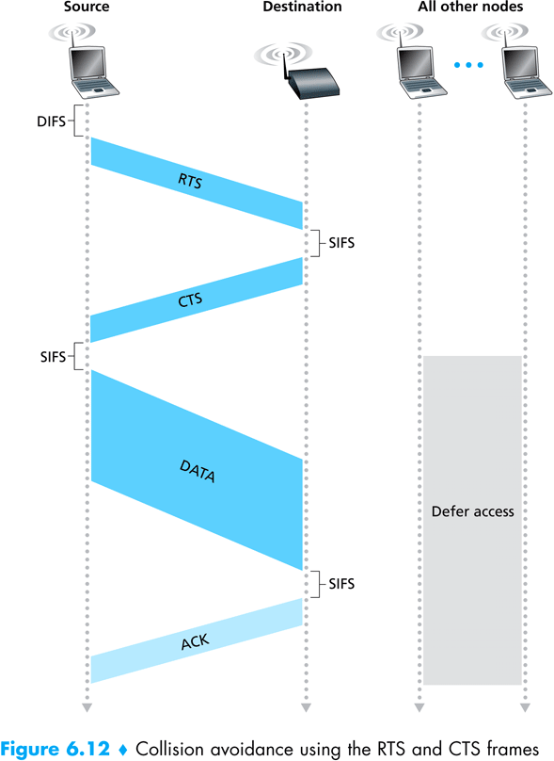
Check Animations on-line (applet & ns)

Slide 102


802.11: mobility within same subnet
H1 remains in same IP subnet: IP address can remain same
switch: which AP is associated with H1?
  self-learning (Ch. 5): switch will see frame from H1 and “remember” which switch port can be used to reach H1
BBS 1
H1
BBS 2

Slide 103
802.11: advanced capabilities
Rate adaptation
base station, mobile dynamically change transmission rate (physical layer modulation technique) as mobile moves, SNR varies
10⁻¹
10⁻²
10⁻³
QAM256 (8 Mbps)
QAM16 (4 Mbps)
BER
10⁻⁴
BPSK (1 Mbps)
operating point
10⁻⁵
10⁻⁶
10⁻⁷
10
20
30
40
SNR(dB)
1. SNR decreases, BER increase as node moves away from base station
Rate adaptation can change rate from
100Mbps to 1Mbps !!
Does this affect higher protocol layers?
2. When BER becomes too high, switch to lower transmission rate but with lower BER

Slide 104
802.11: advanced capabilities
power management
node-to-AP: “I am going to sleep until next beacon frame”
  AP knows not to transmit frames to this node
  node wakes up before next beacon frame
beacon frame: contains list of mobiles with AP-to-mobile frames waiting to be sent
  node will stay awake if AP-to-mobile frames to be sent; otherwise sleep again until next beacon frame

Slide 105

Components of cellular network architecture
MSC
connects cells to wired tel. net.
manages call setup (more later!)
handles mobility (more later!)
cell
covers geographical region
base station (BS) analogous to 802.11 AP
mobile users attach to network through BS
air-interface: physical and link layer protocol between mobile and BS
Mobile
Switching
Center
Public telephone
network
Mobile
Switching
Center
wired network

Slide 106
Wireless Comm. Systems
In general a wireless communication network consists of:
1- Users [Mobile Node/station] (MN)
2- Base Station (BS): connects users to MSC
3- Mobile Switching Center (MSC):
  connects the base stations with each other, and to the PSTN (public switched telephone network)

Slide 107
Cellular Networking Terminology
Hand-off: the process of transferring the mobile from one base station to another
Roamer: a mobile operating in a coverage area other than the one in which it subscribed (moving to another MSC)

Slide 108
Cellular Systems
A cellular system services a large number of users over extended geographical coverage with limited frequency spectrum.
High capacity is attained by limiting the coverage of the base station to a cell, so that the same frequency can be re-used in other cells
A problem may occur when moving from one cell to another while keeping the call un-interrupted. [the hand-off problem]

Slide 109
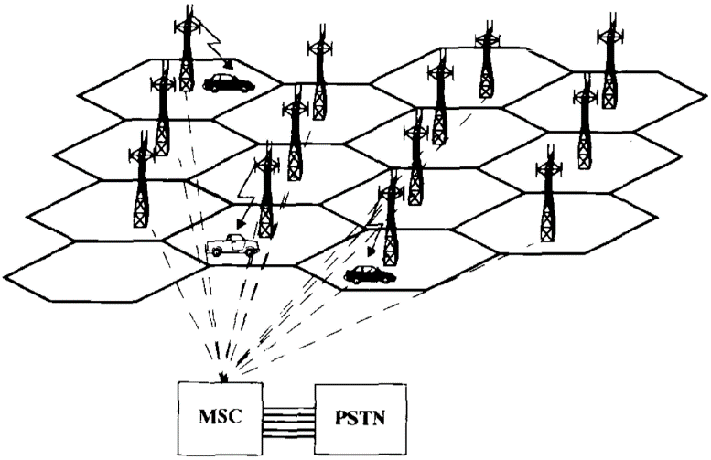
An illustration of a cellular system: The towers are base stations providing
Access between mobile users and the Mobile Switching Center (MSC)

Slide 110
Design concepts: The Cellular Concept and Frequency Re-use
The cellular concept was introduced to solve the problem of frequency limitation,“spectral congestion”, and user capacity
Replace a single high power base station with several lower power base stations, each covering a smaller geographical area, a ‘cell’.
Each of the base stations is allocated a number of channels (portion of the overall system channels)

Slide 111
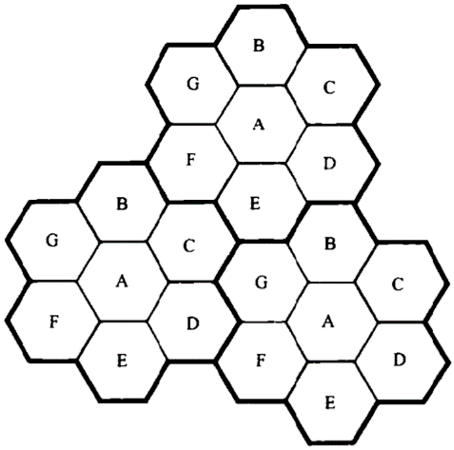
Frequency Re-use
Neighboring base stations (in general) use different frequency channels to reduce interference
A cell uses a set of frequencies
A ‘cluster’ holds several cells
Frequency re-use factor: 1/#cells per cluster

Slide 112
Cluster
B
G
C
B
Cell
A
G
C
B
F
D
A
G
C
E
F
D
A
B
E
F
D
G
C
B
E
A
G
C
F
D
A
E
F
D
E
Cellular frequency re-use concept: cells with the same letter use the same set of frequencies.
A cluster of cells (highlighted in bold) is replicated over the coverage area. The cluster size,
N, is equal to 7. Since each cell contains one-seventh of the overall channels, the cell
frequency re-use factor is 1/7.
This requires channel/frequency planning and allocation!

Slide 113
Hand-off strategies
Mobile moves into a different cell
It monitors the signal strength from the current base station
When power drops below a certain threshold we need hand off

Slide 114
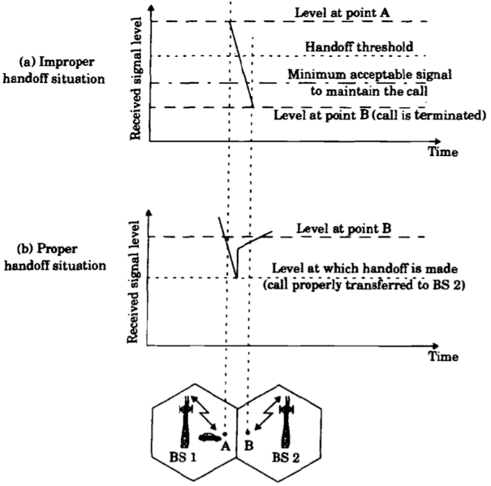
Illustration of a handoff scenario at cell boundary

Slide 115
During handoff: to avoid call termination, allow a safety margin
  Δ=Power__{handoff} – Power__{min usable}
Note:
  Does handoff occur only during movement?
  Even if the mobile is stationary, the signal strength may vary
  with changes in the surrounding environment, so we may need
  a handoff

Slide 116
Handoff in 1st generation:
  Strength of signal measurement is done by the base station and supervised by MSC
Hand off in 2nd generation:
In TDMA: it is mobile assisted handoff (MAHO).
  Every mobile measures the strength of signal to base stations and reports to the serving base station
  Mobile performs measurement during idle time slots
In CDMA: (code division multiple access)
  Soft handoff:
  No change of channel, only change of base station
  The cells use the same frequency and channels
[More later when we talk about CDMA/TDMA]

Slide 117
Co-channel Interference
Exists between signals from co-channel cells (in different clusters)
Co-channel cells are those cells that use the same set of frequencies
Co-channel interference cannot be reduced by strengthening the signal.

Slide 118
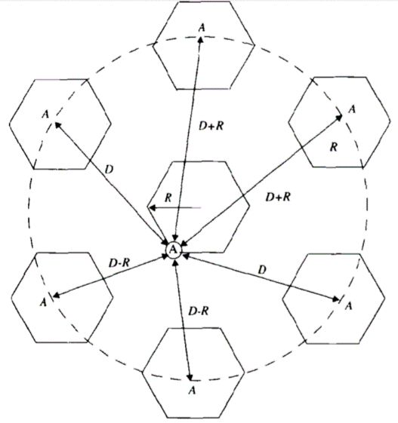
Illustration of co-channel cells for a cluster size of N=7.
When the mobile is at the cell boundary (A), it experiences
worst case co-channel interference on the forward channel.

Slide 119

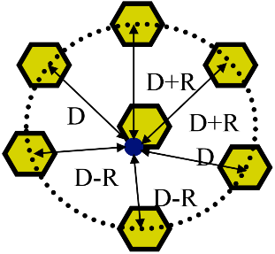
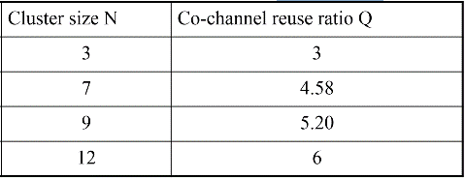
Co-channel Interference (contd.)
Function of cell radius (R), co-channel cell distance (D)
Q=D/R, “Q: co-channel re-use ratio”
As Q increases, the spatial separation between co-channel cells relative to the cell size increases, so interference decreases
Typical co-channel re-use ratio (Q) is 3 - 6

Slide 120
Adjacent Channel Interference
Signals that occupy frequency spectrum adjacent to the desired signal, may cause interference due to imperfect filtering (at the receivers).
The worst interference occurs when the adjacent frequencies are used within the same cell
Can be reduced by filtering and careful channel assignment

Slide 121
Adjacent Channel Interference (contd.)
(1) Channel assignment in a cell:
  Instead of assigning channels from a contiguous band of frequencies
  Channels are assigned such that frequency separations between channels are maximized.
  For example, by sequentially assigning adjacent bands to different cells
  This is called ‘frequency planning’.
(2) A filter is used in the base station to reject power from adjacent channels.

Slide 122
1
2
3
4
5
6
7
8
9
10
11
12
13
14
freq
adjacent
channels
adjacent
channels
B
2
9
G
4
C
5
11
12
1
A
8
F
6
D
7
13
14
E
3
10
Frequency Planning/Channel Assignment

Slide 123
Multiple Access (MA) Techniques for Wireless Communications
MA schemes allow multiple mobile users to share a limited frequency spectrum using multiplexing
Main MA schemes:
  FDMA (frequency division multiple access)
  TDMA (time division multiple access)
  SSMA (spread spectrum multiple access)
  - FHMA (frequency hopping multiple access)
  - CDMA (code division multiple access)
  or DSMA (direct sequency multiple access)
  SDMA (space division multiple access)

Slide 124
Spread Spectrum Multiple Access (SSMA)
Traditional communication techniques
  Strive to conserve bandwidth
By contrast, Spread spectrum techniques
  use bandwidth several orders of magnitude larger than the min. required bandwidth !!

Slide 125
Spread Spectrum Multiple Access (SSMA)
Spread spectrum techniques use bandwidth larger than the min. required bandwidth
Modulation (sender-side encoding):
  Uses pseudo-noise (PN) sequence to convert the signal into wideband
  The PN is random, but can be re-produced by receiver
Demodulation (receiver-side decoding):
  Correct correlation using a PN re-produces the signal
  Using wrong PN sequence produces noise, hence this scheme is ‘secure’

Slide 126
SSMA (continued)
Spread Spectrum (SS) uses two techniques:
  FHMA: frequency hopped MA
  DSMA: direct sequence MA (also called CDMA: code division multiple access)
Frequency Hopped MA (FHMA)
  Frequencies of individual users are varied in a pseudo-random fashion within the wideband range
  The signal is broken into bursts and each burst is sent on a different frequency
Code Division Multiple Access (CDMA) or Direct Sequence Spread Spectrum (DSSS or DSMA)
[next few slides]

Slide 127
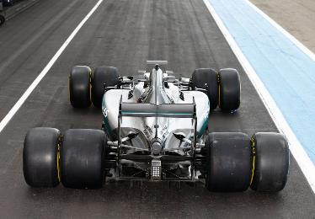
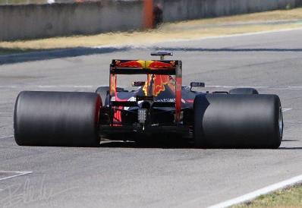

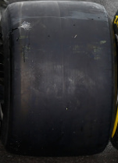
Spread Spectrum Analogy
resilience to fading (bumps on the road)
Frequency hopping (FHMA):
using many wheels,
if some get affected others work
Direct sequence (DSMA/DSSS):
using wide wheels,
if some parts get affected others work

Slide 128
CDMA Advantages
Secure: non-intended recipients (with wrong PN) get noise
Speading the signal power over a wide spread of the frequency spectrum reduces fading effects
  only part of the spectrum & the signal, is affected by fading
  802.11 uses it for its resilience to fading and interference
No frequency planning; users use same frequency
Soft hand-off can be provided since all the cells use the same frequency. MSC monitors signals.
  In soft hand-off the channel frequency remains the same and the base station changes
Supports higher number of users
  not limited by spectrum but by the ‘noise floor’
  Supports 15 times more users than FDMA, 3-5 times TDMA

Slide 129
Spread Spectrum Operation
Symbol
(A)
Channel
en/decoder
(B)
f(B,C)
Chip
(C)
Symbol duration for m(t): Ts
Chip duration for p(t): Tc
Processing Gain PG=W_{ss}/B=Ts/Tc, a measure of interference rejection capability
Example:
  f(B,C)=B⊕C, where
    1 ⊕ 1= 0, 1 ⊕ 0 = 1, 0 ⊕ 1 = 1, 0 ⊕ 0 = 0
  if we have received f(B,C) and we are able to re-generate the PN (C), then we can get B.

Slide 130
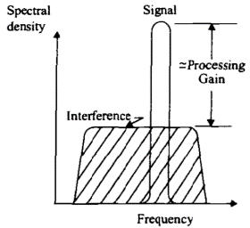
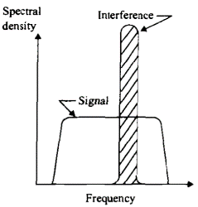
Spread Spectrum Signals
Ts
Signal to send
(B)
m(t)
Tc
Pseudo-noise
sequence
(C)
p(t)
Intended recipient
gets strong
signal and filters
out the noise
Non-intended recipient gets strong noise and cannot receive signal
Noise floor
Noise floor increases
with number of
simultaneous users

Slide 131
Near-far effect in CDMA
all users use same frequency
a user near BS generates high power signal (noise) received at the cell tower
a far away sender will generate less power and its signal may be drowned out by near user
Solutions:
PTx₂
PRx₂
PTx₁
PRx₁
PTx₁: power transmitted by near node
PTx₂: power transmitted by far node
PRx₁: power received from near node
PRx₂: power received from far node
1- Dynamic power control: cell tower tells near users to decrease their power so that all signals arrive at the receiver with similar signal strengths.
2- CDMA-TDMA: Allow one user per time-slot, no noise. Limits number of users but gets some CDMA benefits

Slide 132
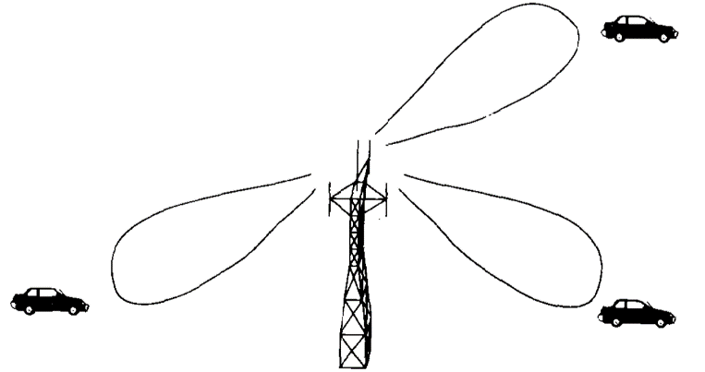
Space Division MA (SDMA)
Controls the radiated energy for each user in space using spot beam (directional) antennas
A spatially filtered base station antenna serving different users by using spot beams

Slide 133
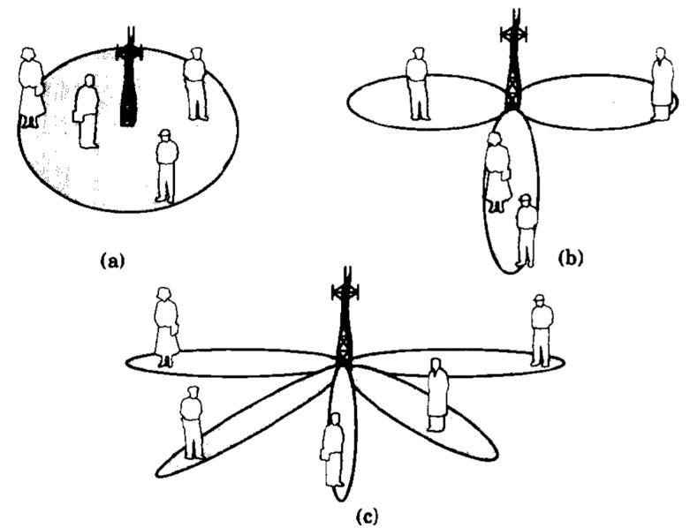
Base Station Antenna Patterns
Omni-directional
Sectorized
Adaptive antenna provides individual spot beams for each user in the cell

Slide 134

Hybrid Mobile Access Systems
FDMA/TDMA: divide spectrum in frequency channels, divide each channel into time slots
time slots
frequency
bands

Slide 135
Hybrid Mobile Systems (contd.)
Time division frequency hopping (TDFH): (GSM)
  User hop to new frequency at start of a TDMA frame
  Hence reducing interference and fading effects
  User hops over pre-defined frequencies
TDMA/CDMA: (CDMA-2000)
  Use CDMA in each time slot
  Get advantages of security and interference resistance, without noise from multiple simultaneous users

Slide 136
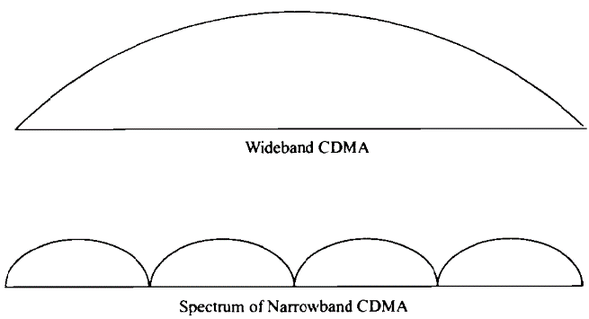
FDMA/CDMA:
  Bandwidth split into subspectra. Each uses CDMA
  Allows to assign subspectra on-demand
FDMA/CDMA
Spectrum of wideband CDMA compared to the spectrum of a hybrid, frequency
Division, direct sequence multiple access

Slide 137
2G (voice) network architecture
Base station system (BSS)
MSC
BTS
BSC
G
Public
telephone
network
Gateway
MSC
Legend
Base transceiver station (BTS)
Base station controller (BSC)
Mobile Switching Center (MSC)
Mobile subscribers

Slide 138
3G (voice+data) network architecture
MSC
G
Public
telephone
network
radio
network
controller
Gateway
MSC
G
Public
Internet
SGSN
Key insight: new cellular data
network operates in parallel
(except at edge) with existing
cellular voice network
voice network unchanged in core
data network operates in parallel
GGSN
Serving GPRS Support Node (SGSN)
Gateway GPRS Support Node (GGSN)

Slide 139
3G versus 4G LTE network architecture
MSC
G
Public
telephone
network
3G
radio
network
controller
Gateway
MSC
G
Public
Internet
SGSN
GGSN
4G-LTE
HSS
MME
G
G
Public
Internet
S-GW
P-GW
radio access network
Universal Terrestrial Radio
Access Network (UTRAN)
Evolved Packet Core
(EPC)

Slide 140



Mobility: vocabulary
home network: permanent “home” of mobile
(e.g., 128.119.40/24)
home agent: entity that will perform mobility functions on behalf of mobile, when mobile is remote
wide area network
permanent address: address in home network, can always be used to reach mobile
e.g., 128.119.40.186

Slide 141
Mobility: more vocabulary
permanent address: remains constant (e.g., 128.119.40.186)
visited network: network in which mobile currently resides (e.g., 79.129.13/24)
care-of-address: address in visited network.
(e.g., 79,129.13.2)
wide area network
foreign agent: entity in visited network that performs mobility functions on behalf of mobile.
correspondent: wants to communicate with mobile

Slide 142
Mobility: approaches
let routing handle it: routers advertise permanent address of mobile-nodes-in-residence via usual routing table exchange.
  routing tables indicate where each mobile located
  no changes to end-systems
let end-systems handle it:
  indirect routing: communication from correspondent to mobile goes through home agent, then forwarded to remote
  direct routing: correspondent gets foreign address of mobile, sends directly to mobile
not
scalable
to millions of
mobiles

Slide 143
Mobility: registration
visited network
home network
1
2
wide area network
mobile contacts foreign agent on entering visited network
foreign agent contacts home agent home: “this mobile is resident in my network”
end result:
foreign agent knows about mobile
home agent knows location of mobile

Slide 144

Mobility via indirect routing
foreign agent receives packets, forwards to mobile
home agent intercepts packets, forwards to foreign agent
visited
network
home
network
3
wide area network
2
1
correspondent addresses packets using home address of mobile
4
mobile replies directly to correspondent

Slide 145
Indirect Routing: comments
mobile uses two addresses:
  permanent address: used by correspondent (hence mobile location is transparent to correspondent)
  care-of-address: used by home agent to forward datagrams to mobile
foreign agent functions may be done by mobile itself
triangle routing: correspondent-home-network-mobile
  inefficient when
  correspondent, mobile
  are in same network

Slide 146
Indirect routing: moving between networks
suppose mobile user moves to another network
  registers with new foreign agent
  new foreign agent registers with home agent
  home agent update care-of-address for mobile
  packets continue to be forwarded to mobile (but with new care-of-address)
mobility, changing foreign networks transparent: on-going connections can be maintained!

Slide 147



Mobility via direct routing
foreign agent receives packets, forwards to mobile
correspondent forwards to foreign agent
visited
network
home
network
3
1
2
4
correspondent requests, receives foreign address of mobile
mobile replies directly to correspondent

Slide 148

Mobility via direct routing: comments
overcome triangle routing problem
non-transparent to correspondent: correspondent must get care-of-address from home agent
  what if mobile changes visited network?
3
1
2
4

Slide 149

Mobile IP: indirect routing
foreign-agent-to-mobile packet
packet sent by home agent to foreign agent: a packet within a packet
dest: 128.119.40.186
dest: 79.129.13.2
dest: 128.119.40.186
Permanent address: 128.119.40.186
Care-of address: 79.129.13.2
dest: 128.119.40.186
packet sent by correspondent

Slide 150

Chapter 6
The Link Layer
and LANs
application
transport
network
link
physical
Computer Networking: A Top Down Approach
7th edition
Jim Kurose, Keith Ross
Pearson/Addison Wesley
April 2016

Slide 151

Error detection
EDC= Error Detection and Correction bits (redundancy)
D = Data protected by error checking, may include header fields
Error detection not 100% reliable!
  protocol may miss some errors, but rarely
  larger EDC field yields better detection and correction
otherwise

Slide 152


Parity checking
single bit parity:
detect single bit errors
two-dimensional bit parity:
detect and correct single bit errors
1
one-bit even parity
Total number of 1’s is even
Ex: 9 1’s in the data, so the even parity bit is ‘1’
0
0
(even parity)
* Check out the online interactive exercises for more examples: http://gaia.cs.umass.edu/kurose_ross/interactive/

Slide 153
10101 1
11110 0
01110 1
00101 0
10101 1
10110 0
00110 1
00101 0
10101 1
10010 0
00110 1
00101 0
10101 1
10010 0
00010 1
00101 0
10101 1
10110 0
01010 1
00101 0

Slide 154




Multiple access links, protocols
two types of “links”:
point-to-point
  PPP for dial-up access
  point-to-point link between Ethernet switch, host
broadcast (shared wire or medium)
  old-fashioned Ethernet
  upstream HFC (hybrid fiber-coaxial cable)
  802.11 wireless LAN
shared wire (e.g.,
cabled Ethernet)
shared RF
(e.g., 802.11 WiFi)
shared RF
(satellite)

Slide 155
Multiple access protocols
single shared broadcast channel
two or more simultaneous transmissions by nodes: interference
  collision if node receives two or more signals at the same time
multiple access protocol
distributed algorithm that determines how nodes share channel, i.e., determine when node can transmit
communication about channel sharing must use channel itself!
  no out-of-band channel for coordination

Slide 156
MAC protocols: taxonomy
three broad classes:
channel partitioning
  divide channel into smaller “pieces” (time slots, frequency, code)
  allocate piece to node for exclusive use
random access
  channel not divided, allow collisions
  “recover” from collisions
“taking turns”
  nodes take turns, but nodes with more to send can take longer turns

Slide 157
Channel partitioning MAC protocols: TDMA
TDMA: time division multiple access
access to channel in "rounds"
each station gets fixed length slot (length = packet transmission time) in each round
unused slots go idle
example: 6-station LAN, 1,3,4 have packets to send, slots 2,5,6 idle
6-slot
frame
6-slot
frame
1
3
4
1
3
4

Slide 158
Channel partitioning MAC protocols: FDMA
FDMA: frequency division multiple access
channel spectrum divided into frequency bands
each station assigned fixed frequency band
unused transmission time in frequency bands go idle
example: 6-station LAN, 1,3,4 have packet to send, frequency bands 2,5,6 idle
time
frequency bands
FDM cable

Slide 159
Random access protocols
when node has packet to send
  transmit at full channel data rate R.
  no a priori coordination among nodes
two or more transmitting nodes ➜ “collision”,
random access MAC protocol specifies:
  how to detect collisions (e.g., no Ack, or bad reception)
  how to recover from collisions (e.g., via delayed retransmissions)
examples of random access MAC protocols:
  ALOHA
  slotted ALOHA
  CSMA: Carrier Sense Multiple Access
  CSMA/CD: CSMA with Collision Detection
  CSMA/CA: CSMA with Collision Avoidance

Slide 160

Pure (unslotted) ALOHA
unslotted Aloha: simple, no synchronization needed
when frame first arrives
  transmit immediately
collision probability increases:
  frame sent at t₀ collides with other frames sent in [t₀-1,t₀+1]

Slide 161
Pure ALOHA efficiency
P(success by given node) = P(node transmits) .
P(no other node transmits in [t₀-1,t₀] .
P(no other node transmits in [t₀-1,t₀]
= p . (1-p)^{N-1 .} (1-p)^{N-1}
= p . (1-p)^{2(N-1)}
… choosing optimum p and then letting n
= 1/(2e) = .18
very bad, can we do better!

Slide 162
Slotted ALOHA
node 1
1
1
1
1
node 2
2
2
2
node 3
3
3
3
C
E
C
S
E
C
E
S
S
Pros:
single active node can continuously transmit at full rate of channel
highly decentralized: only slots in nodes need to be in sync
simple
Cons:
collisions, wasting slots
idle slots
nodes may be able to detect collision in less than time to transmit packet
clock synchronization

Slide 163
Slotted ALOHA: efficiency
efficiency: long-run
fraction of successful slots
(many nodes, all with many frames to send)
max efficiency: find p* that maximizes
Np(1-p)^{N-1}
for many nodes, take limit of Np*(1-p*)^{N-1} as N goes to infinity, gives:
max efficiency = 1/e = .37
suppose: N nodes with many frames to send, each transmits in slot with probability p
prob that given node has success in a slot = p(1-p)^{N-1}
prob that any node has a success = Np(1-p)^{N-1}
at best: channel
used for useful
transmissions 37%
of time!
!

Slide 164
CSMA (carrier sense multiple access)
CSMA: listen before transmit:
if channel sensed idle: transmit entire frame
if channel sensed busy, defer transmission

Slide 165

CSMA collisions
spatial layout of nodes
collisions can still occur: propagation delay means two nodes may not hear each other’s transmission
collision: entire packet transmission time wasted
  distance & propagation delay play role in in determining collision probability

Slide 166
CSMA/CD (collision detection)
CSMA/CD: carrier sensing, deferral as in CSMA
  collisions detected within short time
  colliding transmissions aborted, reducing channel wastage
collision detection:
  easy in wired LANs: measure signal strengths, compare transmitted, received signals
  difficult in wireless LANs: received signal strength overwhelmed by local transmission strength (use CSMA/CA: more in mobile wireless networks)
human analogy: the polite conversationalist

Slide 167

CSMA/CD (collision detection)
spatial layout of nodes

Slide 168
CSMA/CD collision detection
CSMA/CD
CSMA

Slide 169
More on CSMA/CD and Ethernet
uses broadcast and filtration: all stations on the bus receive the frame, but only the station with the appropriate data link D-L (MAC) destination address picks up the frame. For multicast, filteration may be done at the D-L layer or at the network layer (with more overhead)

Slide 170
Analyzing CSMA/CD
Collision
Collision
Success
t1
2 x t1
av. wasted time ~ 5 x t_{prop}
t_{trans}
based on simulations of empirical access patterns & models
Utilization (u) or ‘efficiency’ is fraction of the time used for useful/successful data transmission

Slide 171
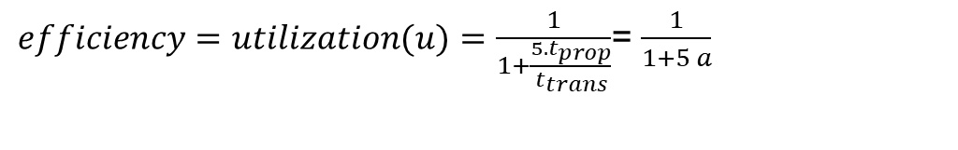
CSMA/CD efficiency
t_{prop} = max prop delay between 2 nodes in LAN
t_{trans} = time to transmit max-size frame
utilization is tx time as fraction of total time (tx time + wasted)
efficiency goes to 1 when ‘a’ is very small
  as t_{prop} goes to 0
  as t_{trans} goes to infinity
  when ‘a’ is small stations learn about collision fast and ‘u’ utilization (i.e., efficiency) increases
  when ‘a’ is large then u decreases
better performance than ALOHA: and simple, cheap, decentralized!
$efficiency=utilization(u)=\frac{1}{1+\frac{5. t_{prop}}{t_{trans}}}$= $\frac{1}{1+5 a}$

Slide 172
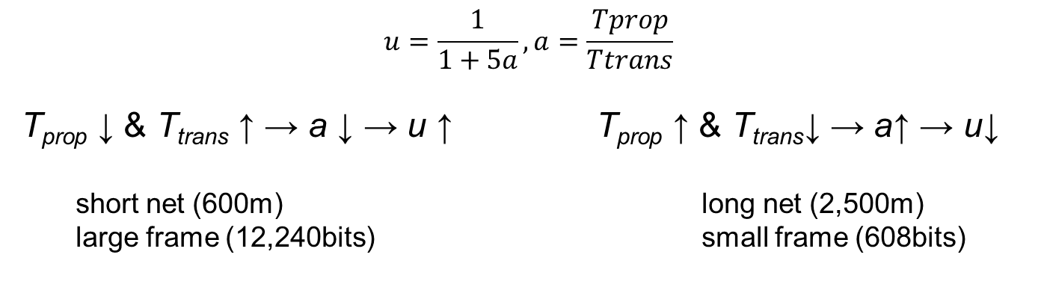



$$u=\frac{1}{1+5a}, a=\frac{Tprop}{Ttrans}$$
T_{prop} ↓ & T_{trans} ↑ → a ↓ → u ↑ T_{prop} ↑ & T_{trans}↓ → a↑ → u↓
short net (600m) long net (2,500m)
large frame (12,240bits) small frame (608bits)
$$\sim 99\%$$
$$u=\frac{1}{1+5a}$$
$$\sim 60\%$$

Slide 173
“Taking turns” MAC protocols
channel partitioning MAC protocols:
  share channel efficiently and fairly at high load
  inefficient at low load: delay in channel access, 1/N bandwidth allocated even if only 1 active node!
random access MAC protocols
  efficient at low load: single node can fully utilize channel
  high load: collision overhead
“taking turns” protocols
  look for best of both worlds!

Slide 174

“Taking turns” MAC protocols
token passing:
control token passed from one node to next sequentially.
token message
concerns:
  token overhead
  latency
  single point of failure (token)
T
(nothing
to send)
T
data

Slide 175
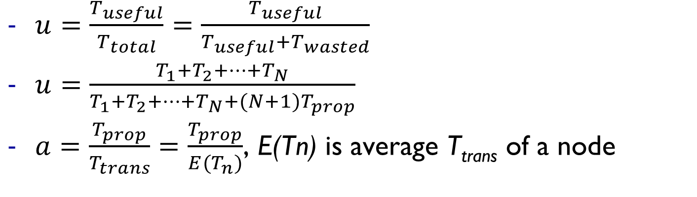
Release after reception: utilization analysis
token
…
token
…
T₁
T₂
T_{N}
T₁
Tprop
Tprop_{1→2}
Tprop
Tprop_{N→1}
$u=\frac{T_{useful}}{T_{total}}=\frac{T_{useful}}{T_{useful}+T_{wasted}}$
$u=\frac{T_{1}+T_{2}+…+T_{N}}{T_{1}+T_{2}+…+T_{N}+(N+1)T_{prop}}$
$a=\frac{T_{prop}}{T_{trans}}=\frac{T_{prop}}{E(T_{n})}$, E(Tn) is average T_{trans} of a node

Slide 176
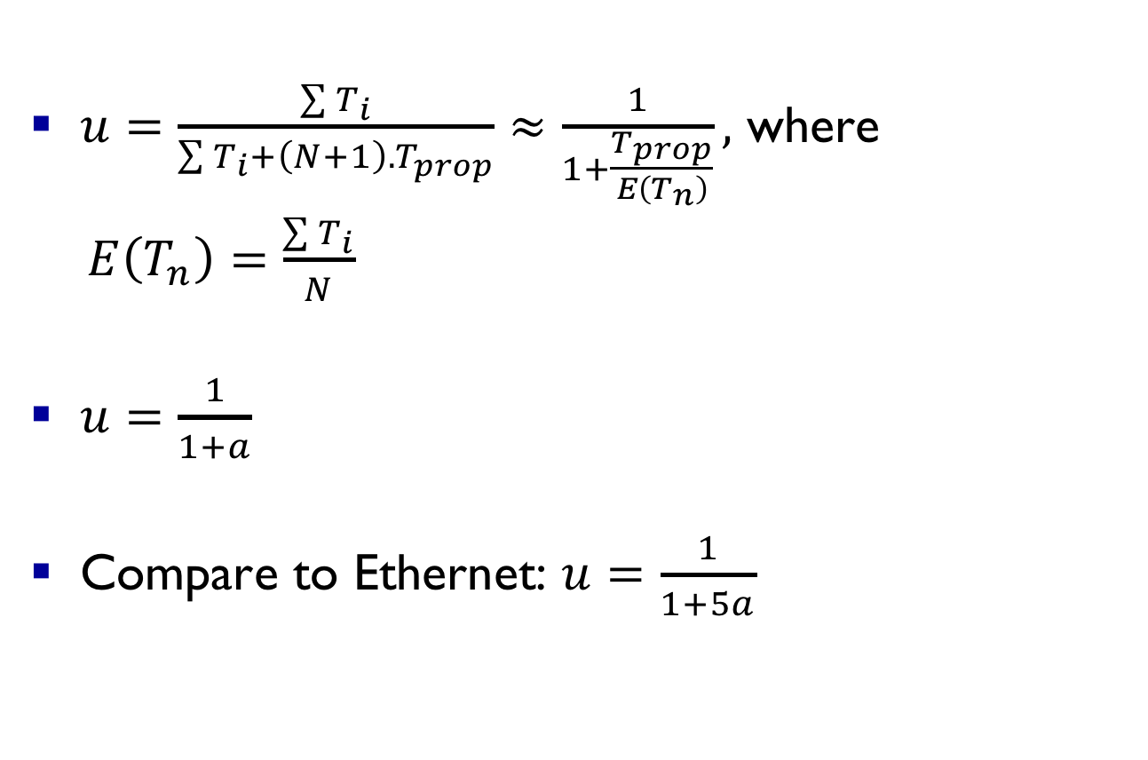
Release after reception (RAR) utilization
$u=\frac{\sum{T_{i}}}{\sum{T_{i}}+{\left(N+1\right).T}_{prop}}≈\frac{1}{1+\frac{T_{prop}}{E\left(T_{n}\right)}},$ where
$E\left(T_{n}\right)=\frac{\sum{T_{i}}}{N}$
$u=\frac{1}{1+a}$
Compare to Ethernet: $u=\frac{1}{1+5a}$

Slide 177

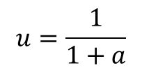
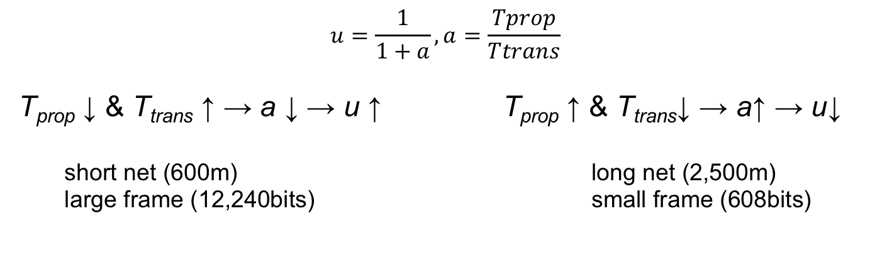
$$u=\frac{1}{1+a}, a=\frac{Tprop}{Ttrans}$$
T_{prop} ↓ & T_{trans} ↑ → a ↓ → u ↑ T_{prop} ↑ & T_{trans}↓ → a↑ → u↓
short net (600m) long net (2,500m)
large frame (12,240bits) small frame (608bits)
$$\sim 99\%$$
$$u=\frac{1}{1+a}$$
$$\sim 83\%$$

Slide 178
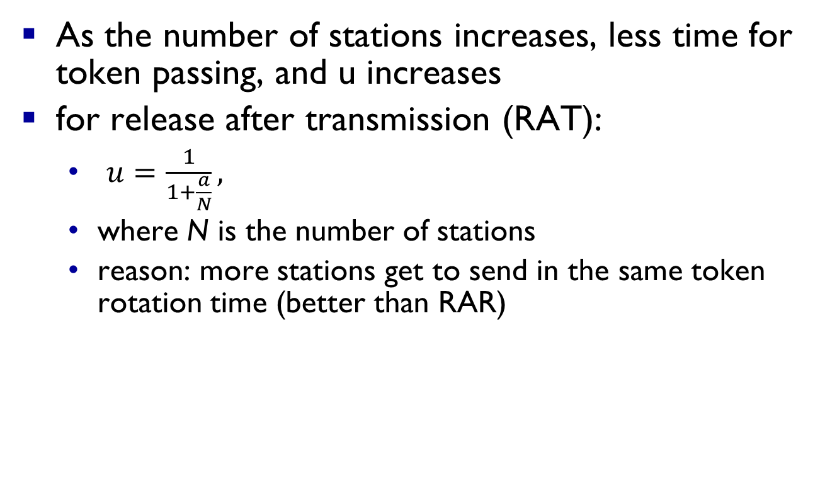
Token Ring: utilization notes
As the number of stations increases, less time for token passing, and u increases
for release after transmission (RAT):
  $u=\frac{1}{1+\frac{a}{N}},$
  where N is the number of stations
  reason: more stations get to send in the same token rotation time (better than RAR)

Slide 179




ARP: address resolution protocol
Question: how to determine
interface’s MAC address, knowing its IP address?
ARP table: each IP node (host, router) on LAN has table
  IP/MAC address mappings for some LAN nodes:
< IP address; MAC address; TTL>
  TTL (Time To Live): time after which address mapping will be forgotten (typically 20 min)
137.196.7.78
1A-2F-BB-76-09-AD
137.196.7.23
137.196.7.14
LAN
71-65-F7-2B-08-53
58-23-D7-FA-20-B0
0C-C4-11-6F-E3-98
137.196.7.88

Slide 180



Self-learning, forwarding: example
Source: A
Dest: A’
A
A A’
frame destination, A’, location unknown:
flood
C’
B
destination A location known:
6
1
2
A A’
A A’
A A’
A A’
selectively send
on just one link
A A’
5
4
3
B’
C
A’ A
A’
MAC addr interface TTL
A
1
60
switch table
(initially empty)
A’
4
60

Slide 181


Interconnecting switches
self-learning switches can be connected together:
S₄
S₁
S₃
A
S₂
F
I
B
C
D
E
G
H
Q: sending from A to G - how does S₁ know to forward frame destined to G via S₄ and S₃?
A: self learning! (works exactly the same as in single-switch case!)

Slide 182

Data center networks
10’s to 100’s of thousands of hosts, often closely coupled, in close proximity:
  e-business (e.g. Amazon)
  content-servers (e.g., YouTube, Akamai, Apple, Microsoft)
  search engines, data mining (e.g., Google)
challenges:
  multiple applications, each serving massive numbers of clients
  managing/balancing load, avoiding processing, networking, data bottlenecks
Inside a 40-ft Microsoft container,
Chicago data center

Slide 183
Data center networks
load balancer: application-layer routing
receives external client requests
directs workload within data center
returns results to external client (hiding data center internals from client)
Internet
Border router
Load
balancer
Load
balancer
Access router
B
Tier-1 switches
Tier-2 switches
(aggregators)
A
C
TOR switches
(Top-of-rack)
Server racks
1
2
3
4
5
6
7
8

Slide 184
Data center networks
rich interconnection among switches, racks:
  increased throughput between racks (multiple routing paths possible)
  increased reliability via redundancy
Tier-1 switches
Tier-2 switches
TOR switches
Server racks
1
2
3
4
5
6
7
8

Slide 185
Data center networks cost (est.)
100,000 host data center ~$12M/month
45% host cost ~$1.3k or $30/m (3-4yr lifetime)
25% infrastructure (transformers, UPS, generators, cooling)
15% electricity!
15% networking (~$1.8M/m): switches, routers, load balancers, external links, transit traffic cost
Total (in 3-4yrs): ~$500M !! (depending!)
More links (optional):
  https://www.youtube.com/watch?v=XZmGGAbHqa0
  https://www.youtube.com/watch?v=yfF3pOzdmlE
  https://www.youtube.com/watch?v=94PO2-TL4Vs
  Search for (Google!) ‘data center cost’ ☺

